Slide 1
Data Cleanup and Transformation

Slide 2
Data Cleaning Checklist (Partial)
Do character variables have valid values?
Are numeric variables are within range?
Are there missing values?
Are there duplicate values?
Are values unique for some variables (e.g., ID variables)?
Are the dates valid?
Do we need to combining multiple data files?

Slide 3
Tools for Data Cleanup
OpenRefine (formerly Google Refine): http://openrefine.org
Data Wrangler: http://vis.stanford.edu/wrangler/
Many other open source and commercial tools

Slide 4
Centering and Scaling
Calculate the “z-score” of each observed value
Generally improves numerical stability
Drawback: loss of interpretability

Slide 5
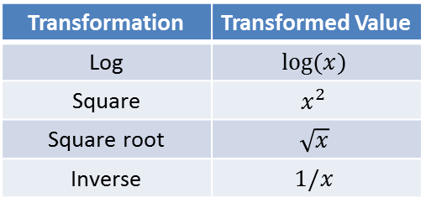
Data Transformation
Common transformations: log, square, square root, or inverse
Transformation | Transformed Value
Log | $$log⁡(x)$$
Square | $$x^{2}$$
Square root | $$\sqrt{x}$$
Inverse | $$1/x$$
Polynomial

Slide 6
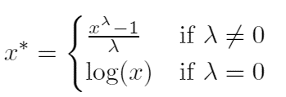
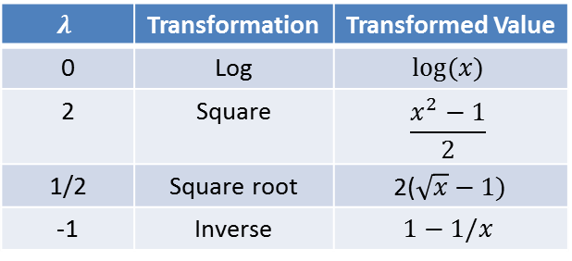
Box and Cox Transformation
Estimate λ from data such that:
Covers all common data transformations
$$λ$$ | Transformation | Transformed Value
0 | Log | $$log⁡(x)$$
2 | Square | $$\frac{x^{2}−1}{2}$$
1/2 | Square root | 2($\sqrt{x}−1)$
-1 | Inverse | $$1−1/x$$

Slide 7
Data Reduction
Acts on multiple variables
Data reduction: reduce the data by generating a smaller set of variables that seek to capture a majority of the information in the original variables

Slide 8
Principle Component Analysis (PCA)
Find linear combinations (i.e., weighted averages) of the variables, known as principal components (PCs), which capture the most possible variance
These linear combinations are uncorrelated (no information overlap), and only a few of them contain most of the original information.
Important to first apply single variable transformations so all original variables are on the same scale

